Slide 1
ABSTRACTIVE TEXT SUMMARIZATION
BY
RUDRARAJU ASRITH VARMA(SE20UCSE150)
UNDER THE GUIDANCE OF
DR. RAGHU KISHORE NEELISETTI
ASSOC. PROF, MAHINDRA UNIVERSITY

Slide 2
PROBLEM STATEMENT
Can abstractive text summarization techniques revolutionize the movie-watching experience?
Current movie summaries often fall short in terms of engagement, as they tend to be generic and lack the personalized touch that resonates with individual viewers.
Moreover, they frequently fail to convey the emotional depth and impact of a film, focusing solely on the plot and missing out on the emotional journey and thematic elements
These summaries provide an incomplete representation of a movie, overlooking crucial elements such as character development, underlying messages, etc.
All this can result in users missing out on movies that align with their specific preferences and interests.
Users may end up watching movies that do not meet their expectations, leading to disappointment and disengagement.
So our project aims to address these key problems
Our project showcases the potential of abstractive text summarization in revolutionizing the movie-watching experience by offering customized and immersive summaries.

Slide 3
MOTIVATION
In today's digital age, where an overwhelming amount of information is available at our fingertips, movie enthusiasts often face the daunting task of choosing the perfect movie to watch.
To assist users in making informed decisions, movie summaries play a crucial role. However, existing summaries often fail to capture the individual preferences and interests of each user, resulting in a generic and impersonalized movie-watching experience

Slide 4
TIMELINE OF ACTIVITIES
Learnt about sequence-to-sequence models and tasks and how they work.
Analysed the previous Approach and then optimized the model and also automated the whole model to be able to run on local PC
Conducted surveys to validate results
Understood about what transformer
models are and how they are used for abstractive text summarization.
Fine-tuned the Pegasus model on our local PC

Slide 5
BACKGROUND AND RELATED WORK
Abstractive Sentence Summarization with Attentive Recurrent Neural Networks (2016):
In their paper, Sumit Chopra, Michael Auli, and Alexander Rush proposed an attentive RNN model for abstractive text summarization. The model used an encoder-decoder architecture with an attention mechanism to generate concise and fluent summaries. While the RNN model had limitations in capturing long-range dependencies, the paper highlights the need for the Transformer architecture to address this issue.
Attention is all you need (2017):
The paper introduces the transformer architecture for abstractive text summarization, using attention to capture long-range dependencies. It outperforms previous methods in various tasks, offering parallel computation and improved learning of dependencies.
PEGASUS: Pre-training with Extracted Gap-sentences for Abstractive Summarization (2020):
We leverage transformer-based architectures like PEGASUS, which combines pre-training on large text corpora and fine-tuning on human-written summaries. This enables us to generate fluent and informative personalized movie summaries based on user viewing history.

Slide 6
OVERVIEW OF DATASET
We have decided to use IMDB dataset which nearly 1 million unique movie reviews from 1150 different IMDb movies spread across 17 IMDb genres - Action, Adventure, Animation, Biography, Comedy, Crime, Drama, Fantasy, History, Horror, Music, Mystery, Romance, Sci-Fi, Sport, Thriller and War.
The dataset also contains movie metadata such as date of release of the movie, run length, IMDb rating, movie rating (PG-13, R, etc), number of IMDb raters, and number of reviews per movie.

Slide 7
PREVIOUS IMPLEMENTATION
Importing Dataset and all the libraries useful for preprocessing and loading the dataset:
We imported essential libraries such as pandas, numpy, os, re, and glob. Assuming the user's history consists of romance genre movies, we utilized the pd.read_csv function to read movie reviews specific to the Romance genre from the dataset, resulting in a Data Frame named romance_df.
We utilized the IMDb Movie Reviews dataset, available at the provided link, for personalized movie summarization based on user viewing history. The dataset includes nearly 1 million unique movie reviews from 1150 IMDb movies across 17 genres.
Python was chosen as the programming language due to its extensive libraries for NLP tasks, with Transformers being used to import the PEGASUS model.
After importing necessary libraries, we focused on the Romance genre, reading movie reviews specific to it into a DataFrame named romance_df. We extracted movie names and release years, created a DataFrame combined_reviews_romance to store combined and helpful reviews for each movie, and preprocessed the text by removing unwanted characters using regular expressions.

Slide 8
NEW IMPLEMENTATION
Importing Dataset and all the libraries useful for preprocessing and loading the dataset:
We imported essential libraries such as pandas, numpy, os, re, and glob. Assuming the user's history consists of romance genre movies, we utilized the pd.read_csv function to read movie reviews specific to the user input.
We utilized the IMDb Movie Reviews dataset, available at the provided link, for personalized movie summarization based on user viewing history. The dataset includes nearly 1 million unique movie reviews from 1150 IMDb movies across 17 genres.
Python was chosen as the programming language due to its extensive libraries for NLP tasks, with Transformers being used to import the PEGASUS model.
After importing necessary libraries, we focused on the movies present in user input, reading movie reviews specific to it into a DataFrame named combined_reviews_user. We extracted movie names and release years, created a DataFrame to store combined and helpful reviews for each movie in such a way that we selected top-3 helpful reviews for each movie and from remaining reviews we have made them into 3 parts and then assigned each part to the 3 helpful reviews thereby having 3 rows to each movie present in the user input, and preprocessed the text by removing unwanted characters using regular expressions.

Slide 9
Fine-tuning the PEGASUS-xsum model:
To fine-tune the PEGASUS model, we created a custom dataset class called Pegasus Dataset, inheriting from torch.utils.data.Dataset. This class handles encodings and decoding, and implements essential methods like getitem and len.
We used our own PC for fine-tuning the Pegasus-XSum model instead of using a Super Computer, as we have significantly reduced the number of epochs and dataset, thereby reducing computational complexity. The code involved importing libraries, defining a custom dataset class, preparing data, and training the model using the Trainer class. The fine-tuned model was saved for future use
Testing the fine-tuned model:
We loaded the fine-tuned model from the saved directory using the PegasusForConditionalGeneration.from_pretrained() function.
We encoded many sample input texts using the tokenizer and used the fine-tuned model to generate a summary.

Slide 10
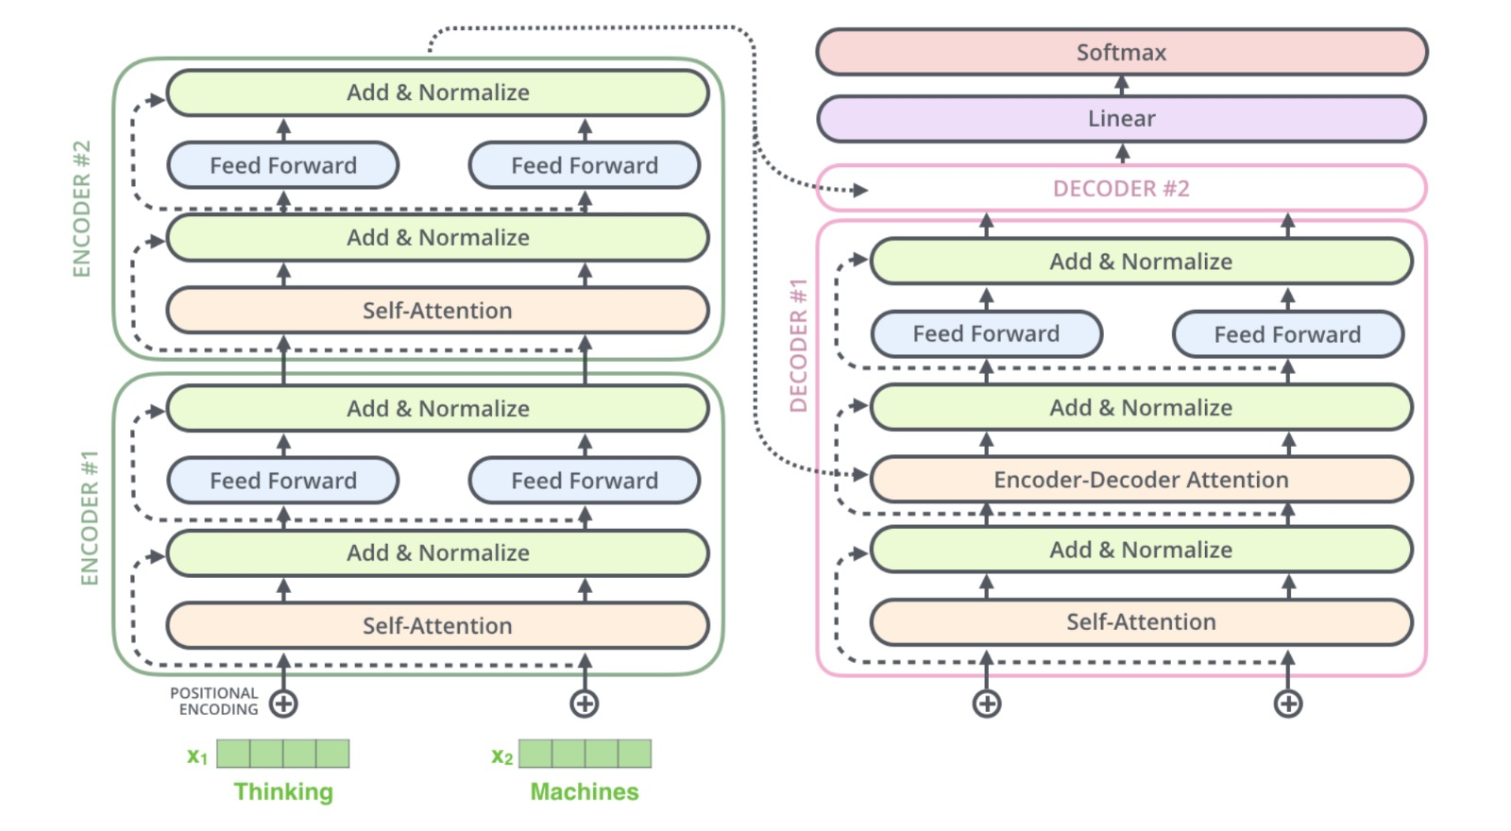
TRANSFORMER ARCHITECTURE

Slide 11


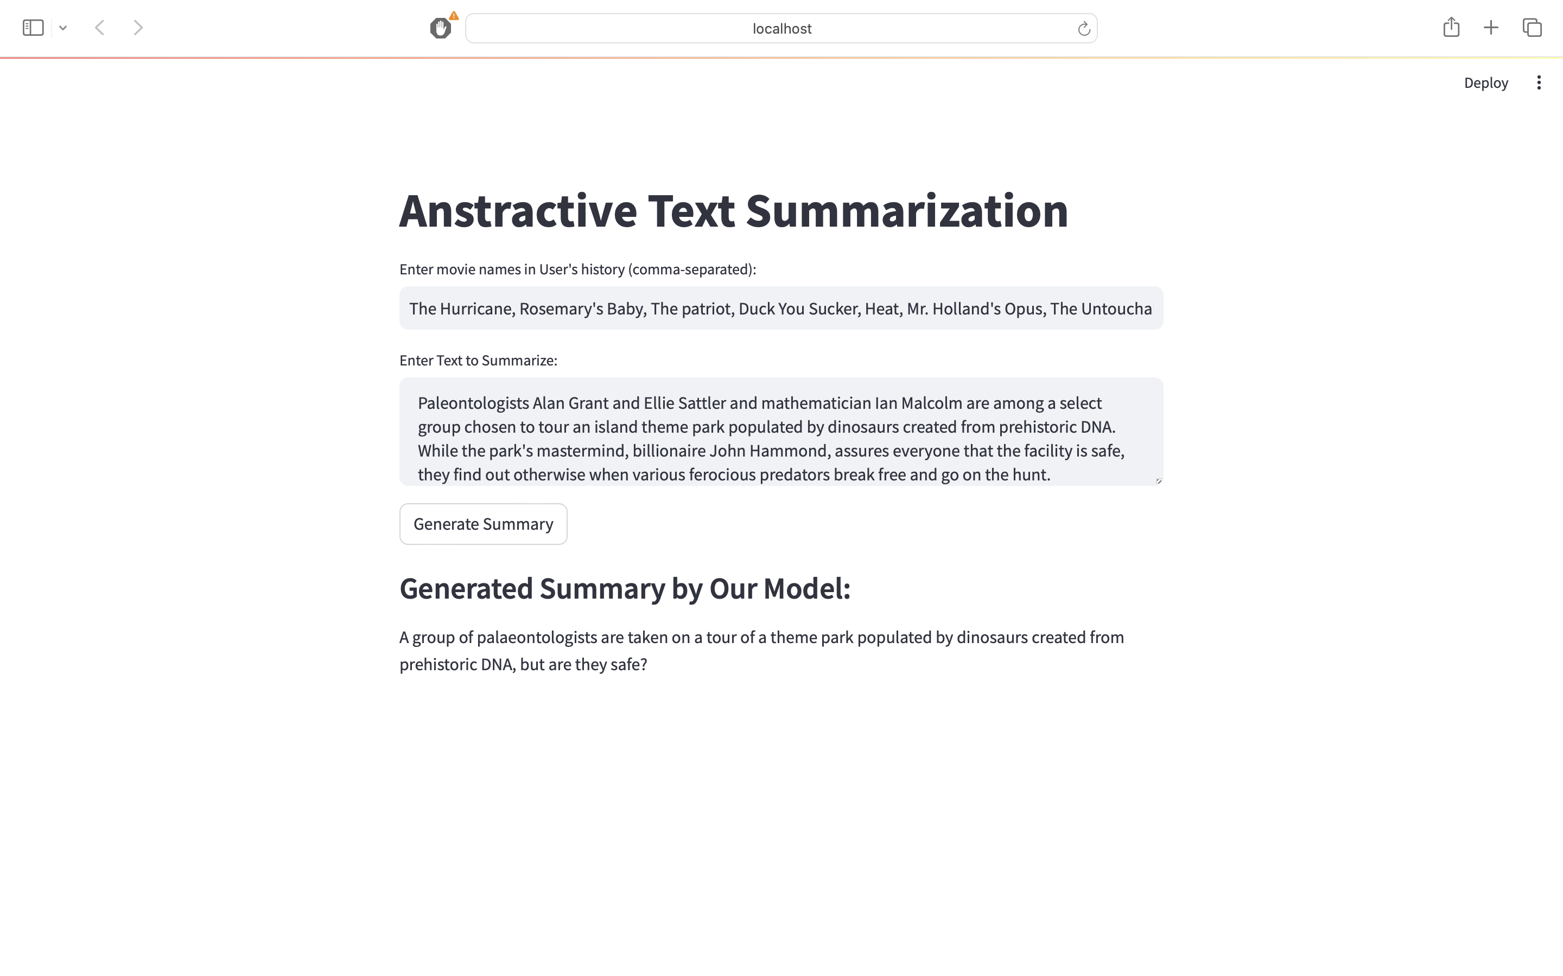



DEMO

Slide 12
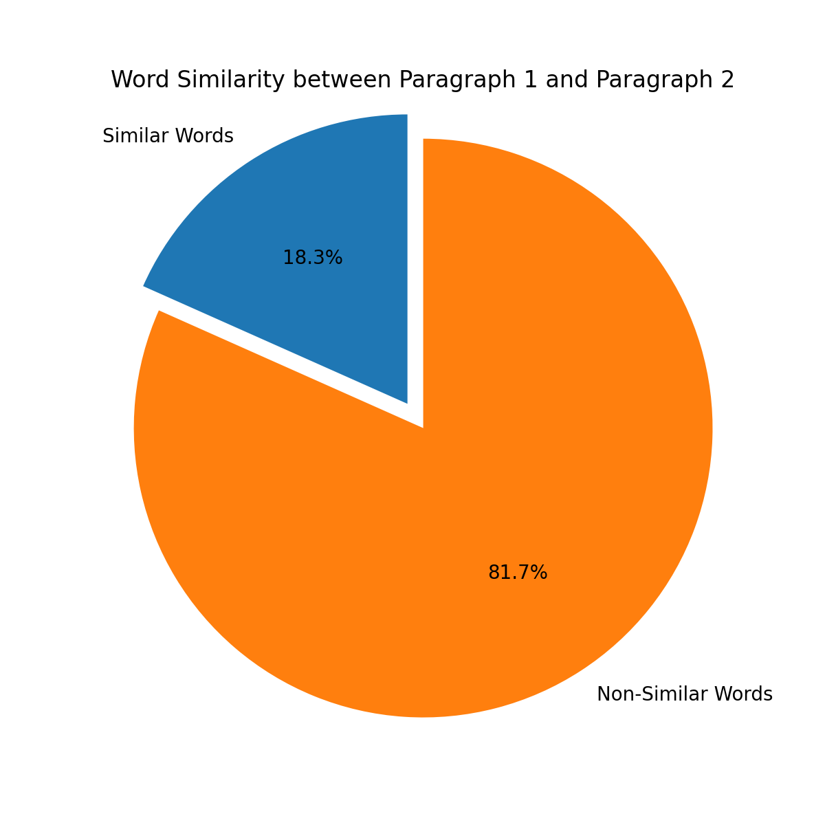
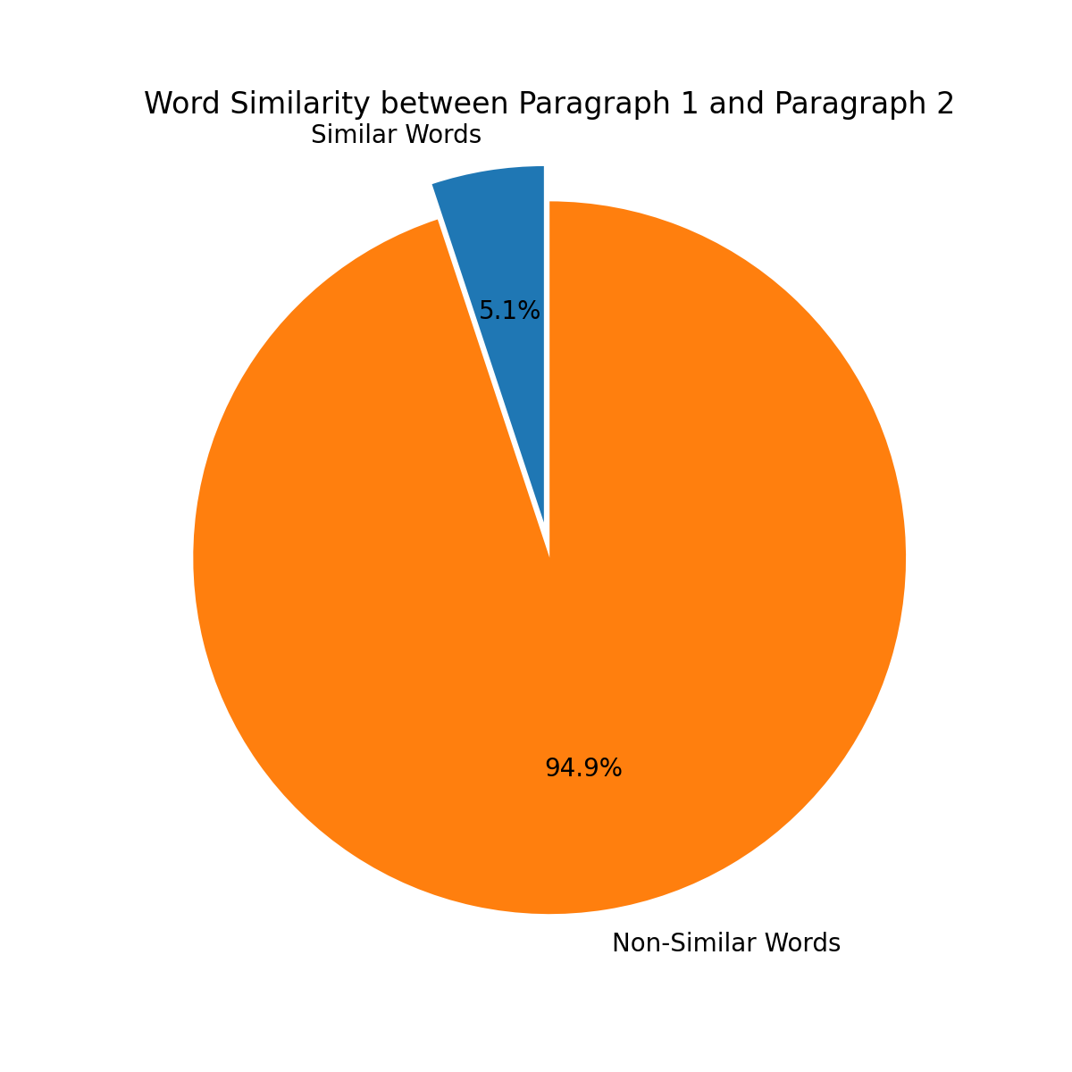
RESULTS AND VALIDATION
To check abstractive accuracy of the generated summary:
We developed a Python code to measure word similarity between paragraphs. It counts word frequency, identifies common words excluding short ones, and calculates the percentage of similarity. This helps assess the abstractive accuracy of the generated summary.

Slide 13
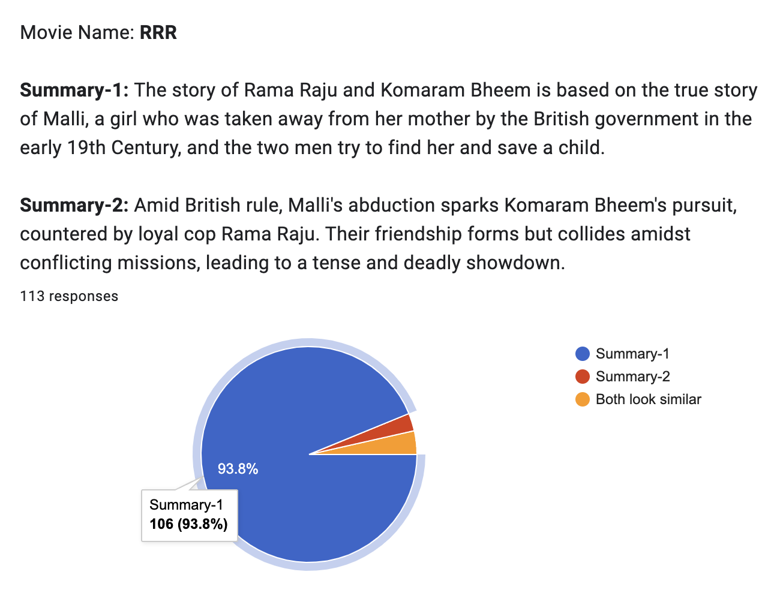
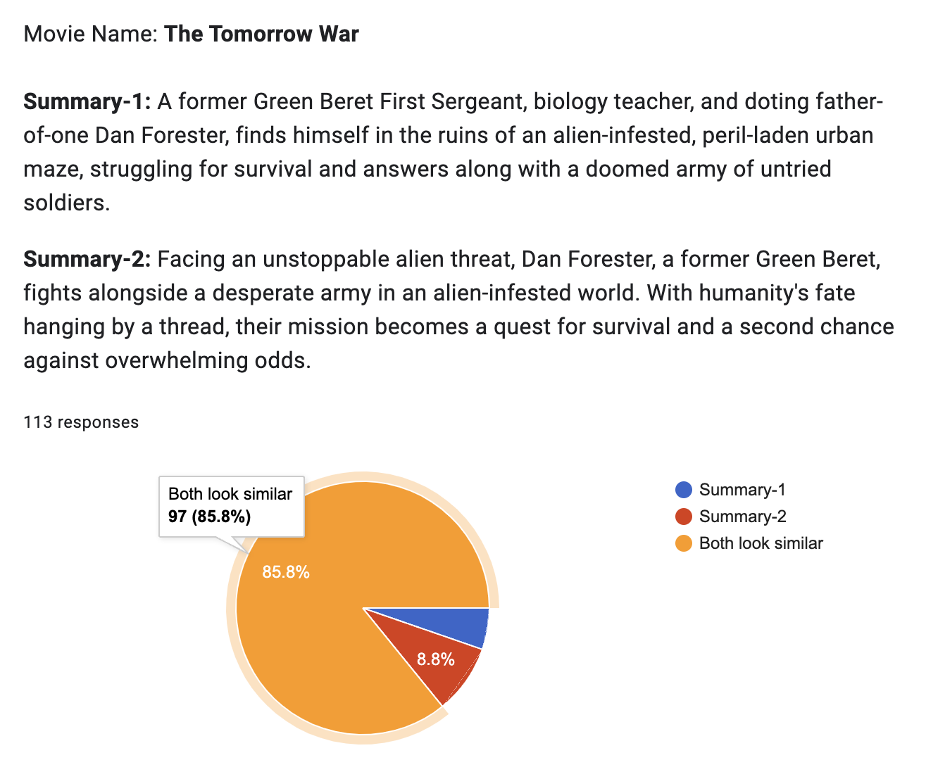
RESULTS AND VALIDATION
To check how close the generated summary is to the people’s expectations:
We conducted an online survey using Google Forms to assess the relevance of the model-generated summary. Participants were asked to read both the reviews generated by ChatGPT and our model(we didn't explicitly mention it, to avoid bias). Here are the survey statistics:

Slide 14
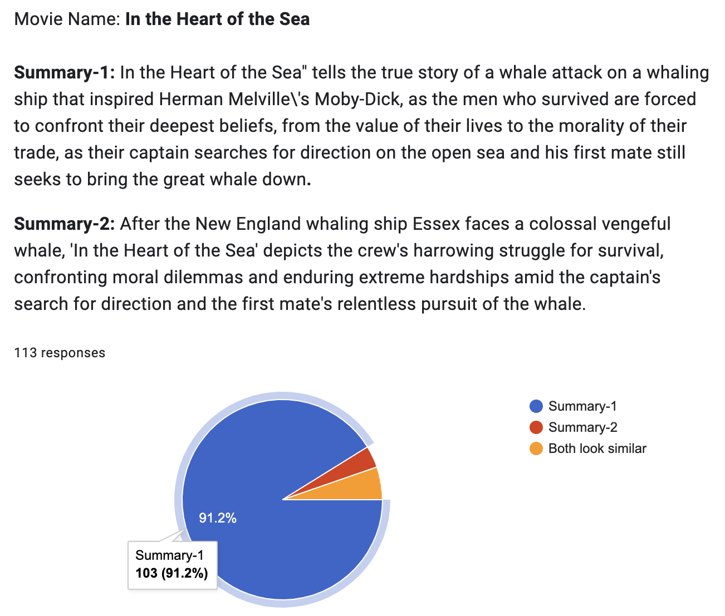
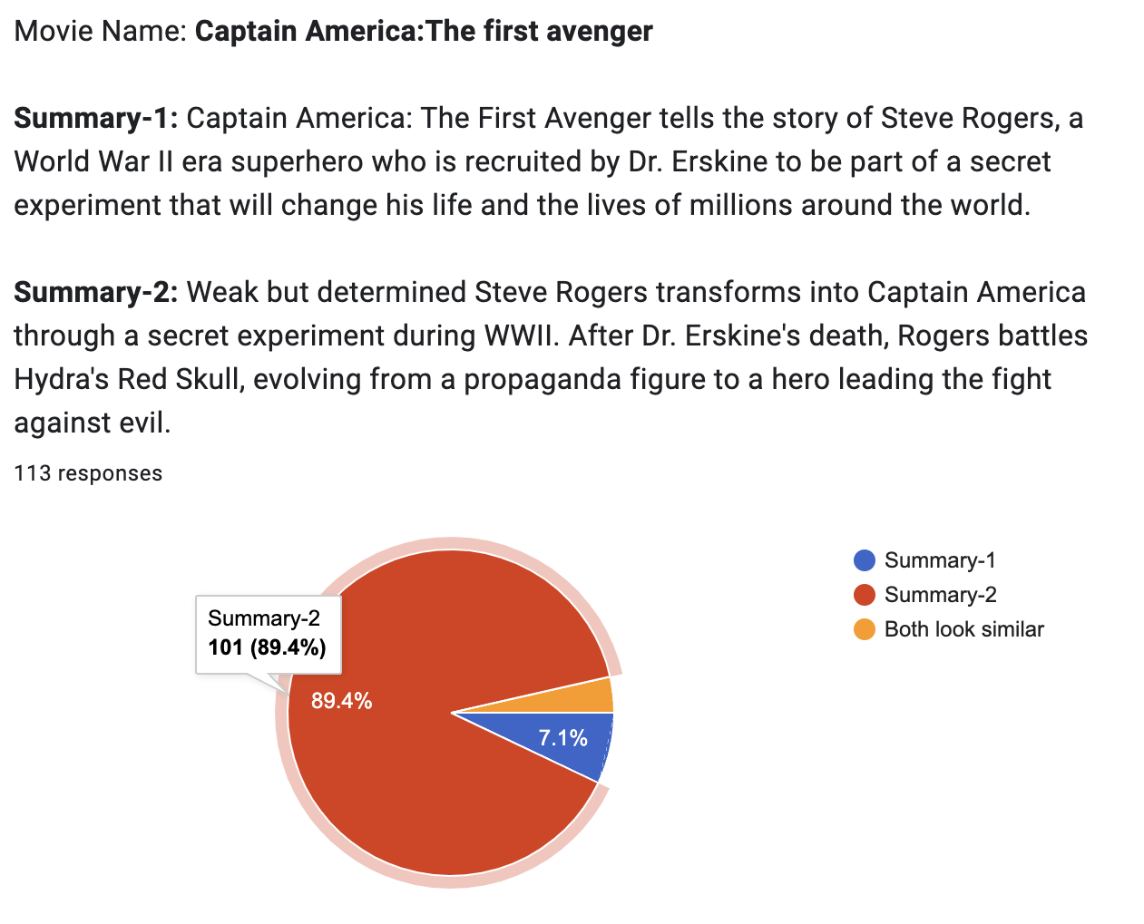
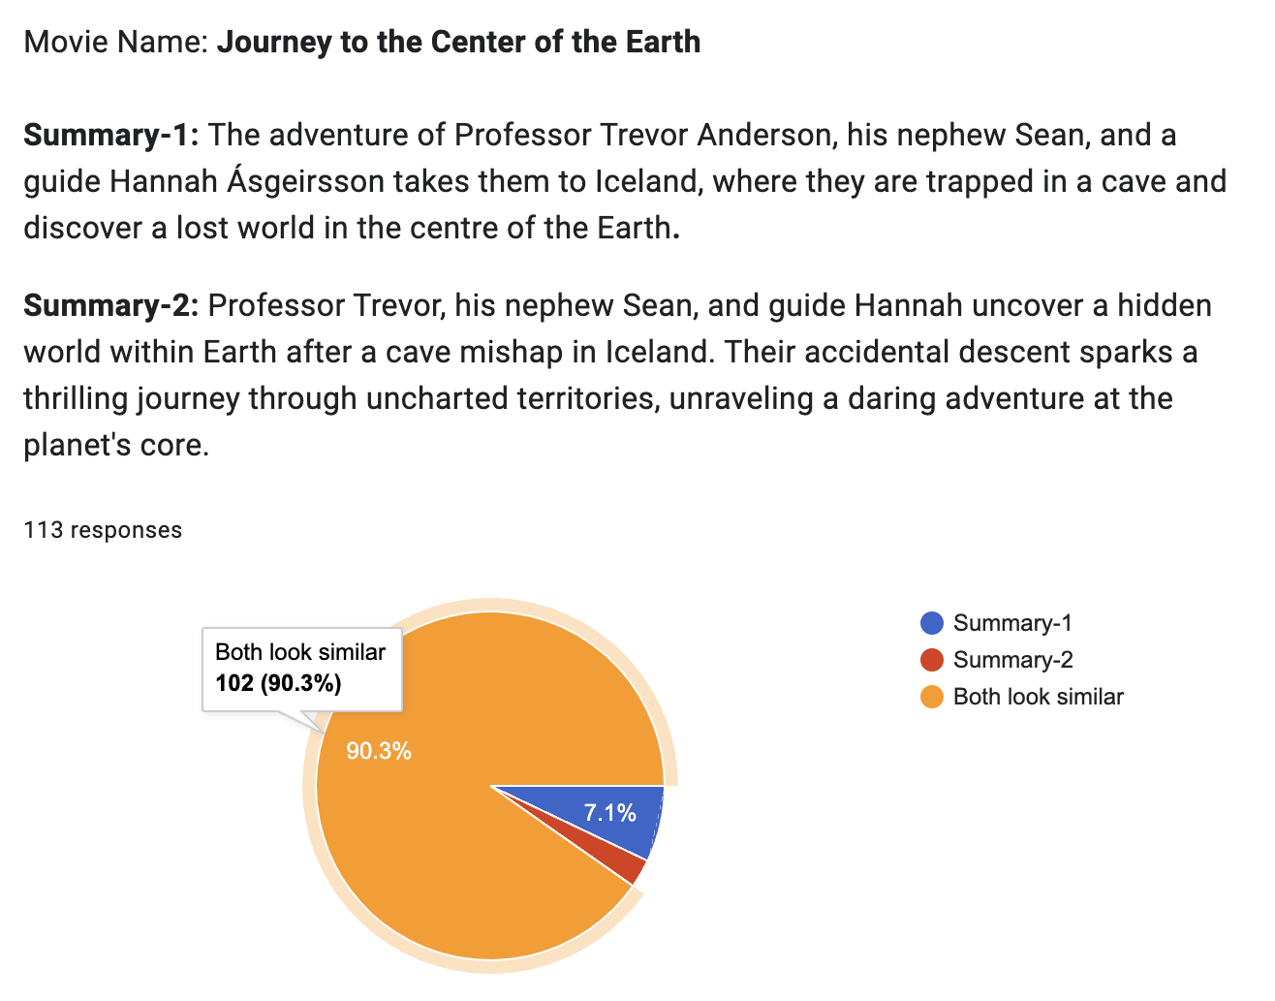
RESULTS AND VALIDATION

Slide 15
CONCLUSION
In summary, our abstractive summarization project focused on generating concise and meaningful summaries using advanced natural language processing techniques.
With the help of models like Pegasus-X Sum, we successfully fine-tuned large-scale models for generating human-like abstractive summaries on our local PC and compared them to ChatGPT generated summaries.
We have reduced computational time and efforts by reducing number of epochs and size of the dataset since pre-trained models are already trained on huge corpus of data.
While the results were promising, there is still room for improvement in terms of accuracy evaluation and user feedback incorporation.
Moving forward, we aim to advance the field of abstractive summarization by exploring new techniques, refining evaluation methodologies, and catering to specific domains and user preferences.

Slide 16
REFERENCES
[1] Ashish Vaswani-Google Brain, Naam Shazeer-Google Brain, Niki Parmar-Google Research, Jakob Uszkoreit-Google Research, Llion Jones-Google Research, Aidan N.Gomez-University of Toronto, Lukasz Kaiser-Google Brain, Illia Polosukhin. “Attention Is All You Need”.
[2] Alex Graves, “Generating sequences with recurrent neural networks.” arXiv preprint arXiv: 1308.0850, 2013.
[3] Minh-Thang Luong, Hieu Pham, and Christopher D Manning. “Effective approaches to attention-based neural machine translation”. arXiv preprint arXiv: 1508.04025, 2015.
[4] Romain Paulus, Caiming Xiong, and Richard Socher. “A deep reinforced model for abstractive summarization”. arXiv preprint arXiv: 1705.04304, 2017.
[5] Sumit Chopra-Facebook AI Research, Micheal Auli-Facebook AI Research, Alexander M.Rush-Harvard SEAS. “Abstractive Sentence Summarization with Attentive Recurrent Neural Networks”, 2016.
[6] Jingqing Zhang, Yao Zhao, Mohammad Saleh, Peter J. Liu. “PEGASUS - Pre-training with Extracted Gap-sentences for Abstractive Summarization”, 2020.
[7] Goodman, S., Lan, Z., and Soricut, R. “Multi-stage pretrain-ing for abstractive summarization”, 2019.
[8] “IMDb Movie Reviews Dataset”.
Link: https://ieee-dataport.org/open-access/imdb-movie-reviews-dataset
[9] “Hugging Face Google/pegasus-xsum model”.
Link: https://huggingface.co/google/pegasus-xsum/tree/main
[10] “Pytorch script for fine-tuning Pegasus Large model”

Slide 17
Thank You

